Slide 1

UNIVERSITY INSTITUTE OF ENGINEERING
COMPUTER SCIENCE ENGINEERING
Bachelor of Engineering (Computer Science & Engineering)
Subject Name: Big Data Analytics
Subject Code: 20CST-471
Introduction to Data Warehousing
Mapped with CO3
Prepared By:
Er. Ankita Sharma
DISCOVER . LEARN . EMPOWER

Slide 2
Data Warehousing
Data Warehousing is a strategic approach to managing and analyzing large volumes of data collected from various sources within an organization.
It involves the consolidation of data into a centralized repository, known as a data warehouse, to facilitate efficient querying, reporting, and analysis. Unlike traditional transactional databases, which are optimized for day-to-day operations, data warehouses are designed to support complex analytical queries and business intelligence.

Slide 3
Data Sources:
Data warehouses aggregate data from a variety of sources, including transactional databases, applications, logs, external partners, and more. These sources can be both internal and external to the organization.
ETL Processes (Extract, Transform, Load):
ETL processes are employed to extract data from source systems, transform it into a consistent and standardized format, and load it into the data warehouse. This ensures that the data is suitable for analysis and reporting. 3233, 133, 44.
Data Warehouse:
The data warehouse is a centralized repository that stores historical and current data in a structured and optimized format. It typically uses dimensional modeling techniques, consisting of fact tables and dimension tables, to organize data for analytical purposes.

Slide 4
Metadata Management:
Metadata, which provides information about the data, its source, and its meaning, is crucial in a data warehouse. Effective metadata management ensures that users can understand and trust the data they are working with.
Query and Reporting Tools:
Data warehouses provide users with query and reporting tools that enable them to retrieve and analyze data. These tools often support complex queries, ad-hoc reporting, and visualization to facilitate data-driven decision-making.

Slide 5
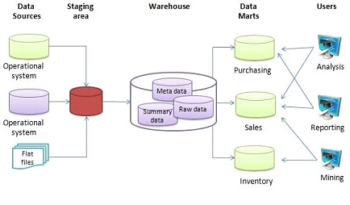

Slide 6
Benefits of Data Warehousing:
Centralized Data Repository:
Data warehouses consolidate data from disparate sources into a single, centralized repository, providing a unified view of the organization's information.
Improved Data Quality:
ETL processes and data cleansing activities in data warehousing improve data quality by resolving inconsistencies and errors in the source data.
Enhanced Business Intelligence:
Data warehouses support advanced analytics and business intelligence by providing a structured and optimized environment for querying and reporting.
Historical Analysis:
With the inclusion of historical data, data warehouses allow organizations to perform trend analysis and understand changes over time, supporting strategic planning.

Slide 7
Decision Support:
Data warehouses empower decision-makers with timely and accurate information, enabling them to make informed and data-driven decisions.

Slide 8
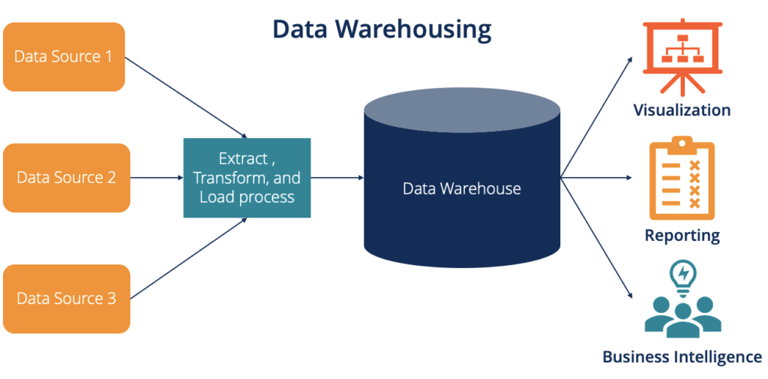

Slide 9
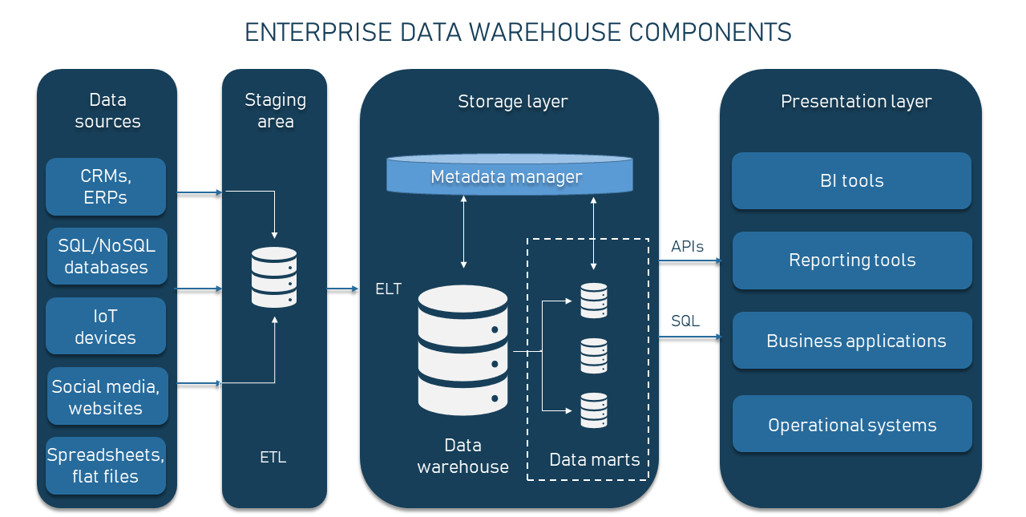

Slide 10
Thankyou

